Slide 1
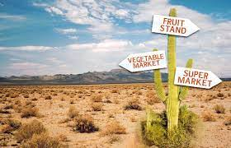

USA Food Deserts
April 2021

Slide 2





Team Members
Paul Nisenson
Sushama Kunnath
Aditi Rai Malhotra
Billy Donahue
Chris Grove

Slide 3
What is a Food Desert?
A food desert is an urban or rural area where the availability of affordable, fresh, healthy food is limited. While food deserts can be defined in several ways, generally, a food desert is defined by some measure of distance (e.g. 1 mile) to access from a supermarket.
The issue of food deserts is an ethical one, as residents of these areas tend to be more likely to have diet-related health issues such as obesity.

Slide 4

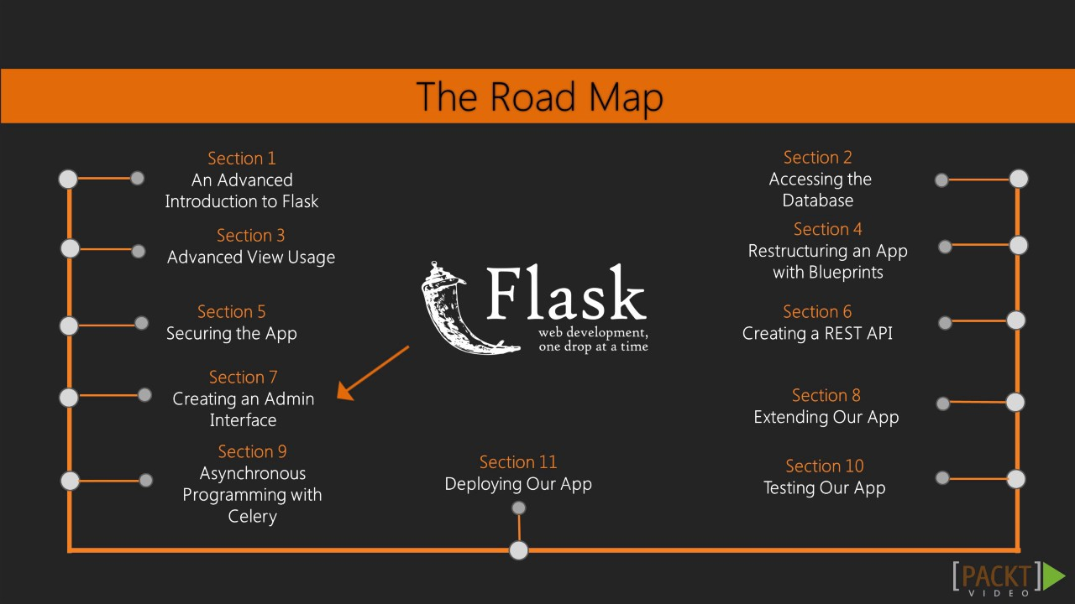








Tools
Python
Flask
Postgres
Sklearn
TenserFlow
Pandas
Tableau
HTML
CSS
Bootstrap
Lucid Charts

Slide 5
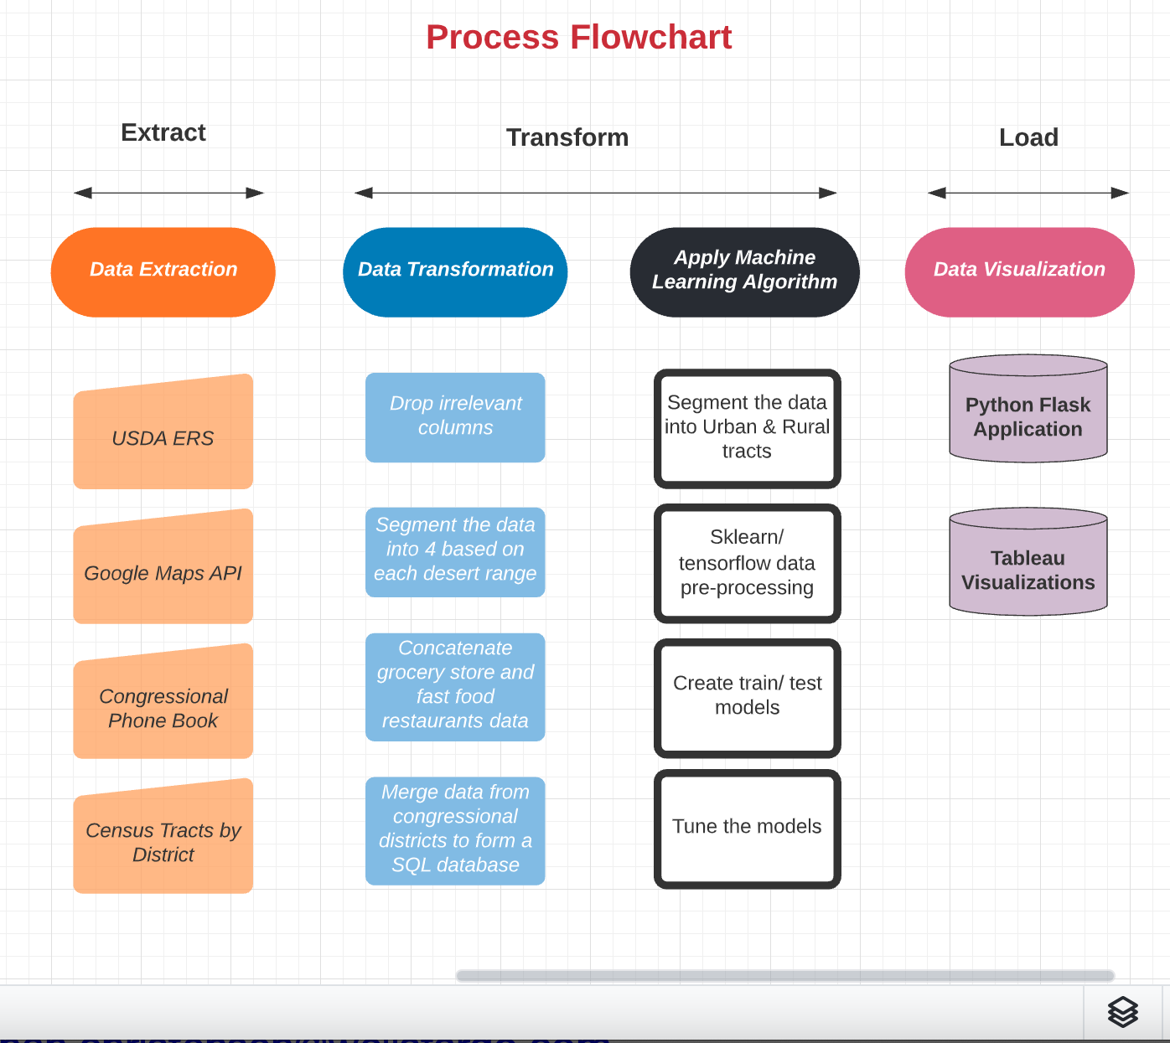

Slide 6
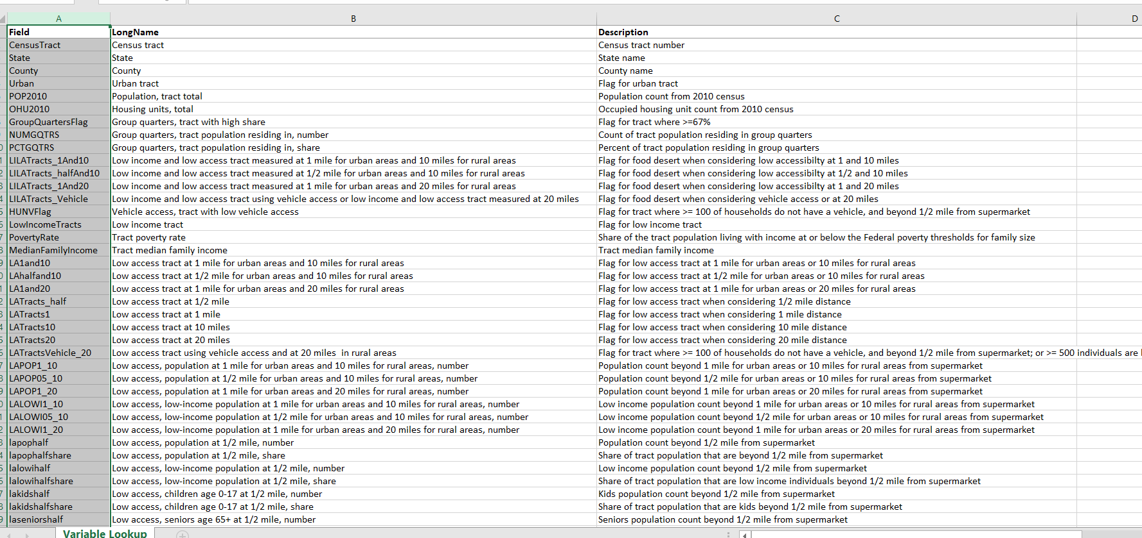
Dataset – from USDA

Slide 7
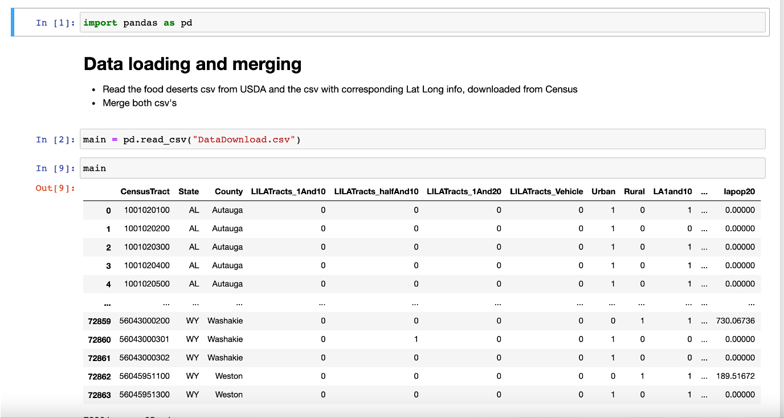
USDA Data Cleaning (1/2)
Check for NaN values & merge latitude, longitude from Census

Slide 8
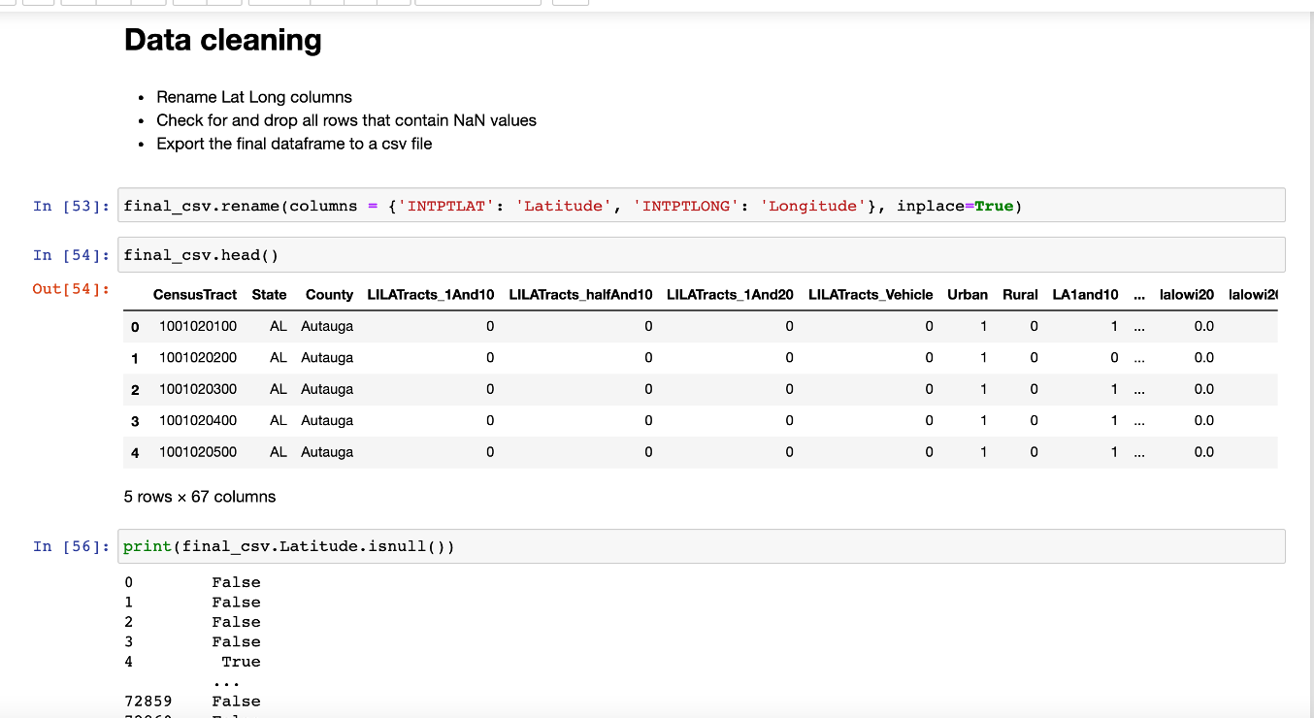
USDA Data Cleaning (2/2)

Slide 9
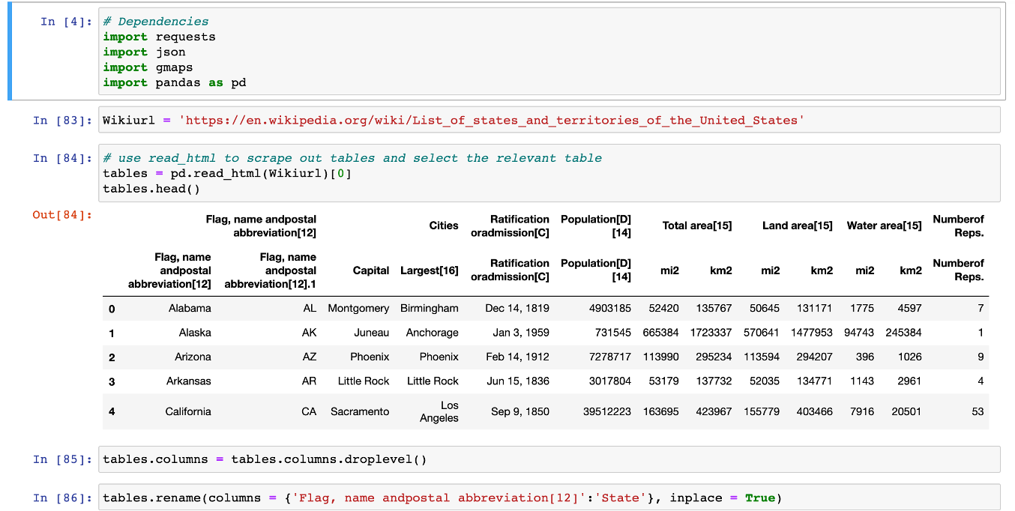
Pull grocery store locations from Google Maps API (1/3)

Slide 10
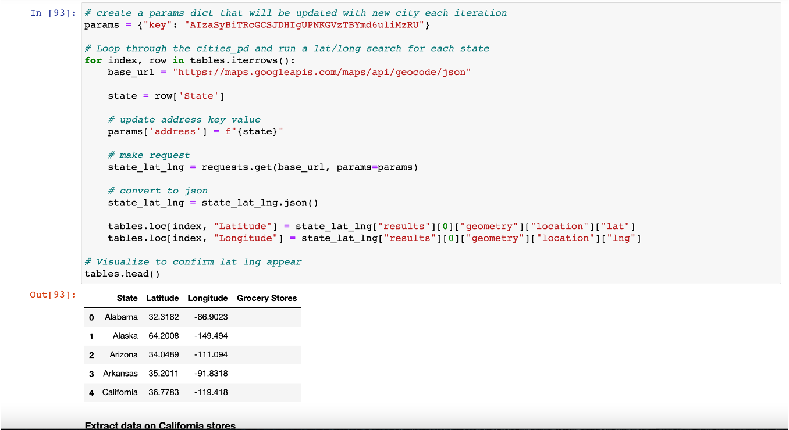
Pull grocery store locations from Google Maps API (2/3)

Slide 11
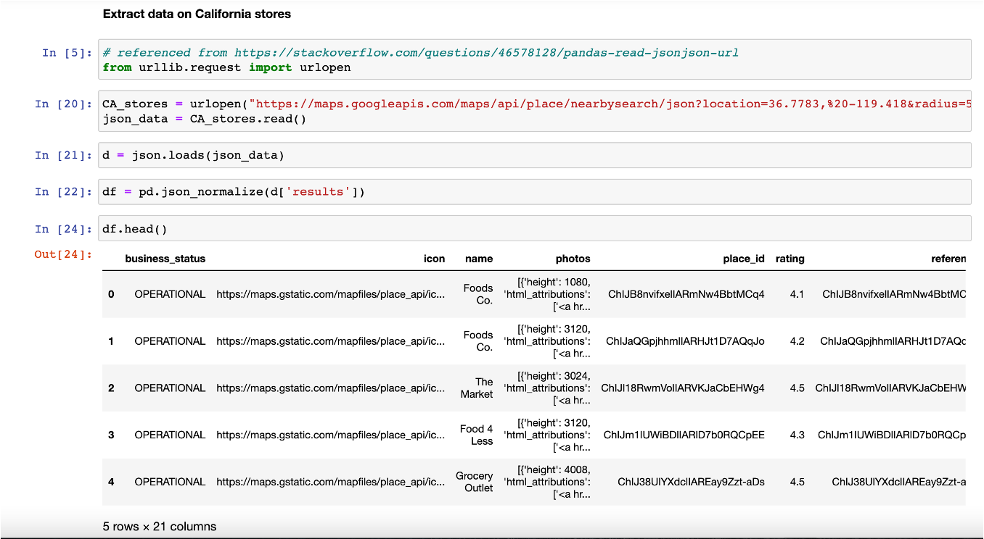
Pull grocery store locations from Google Maps API (3/3)

Slide 12
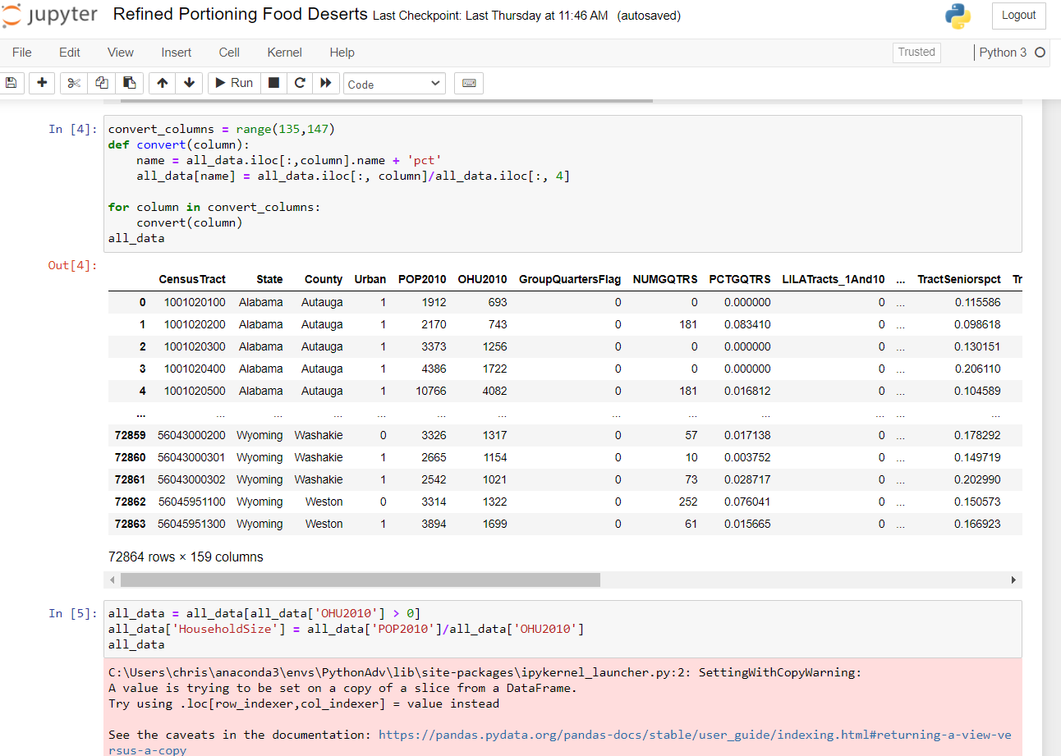
Adding Demographic % and Household Size

Slide 13
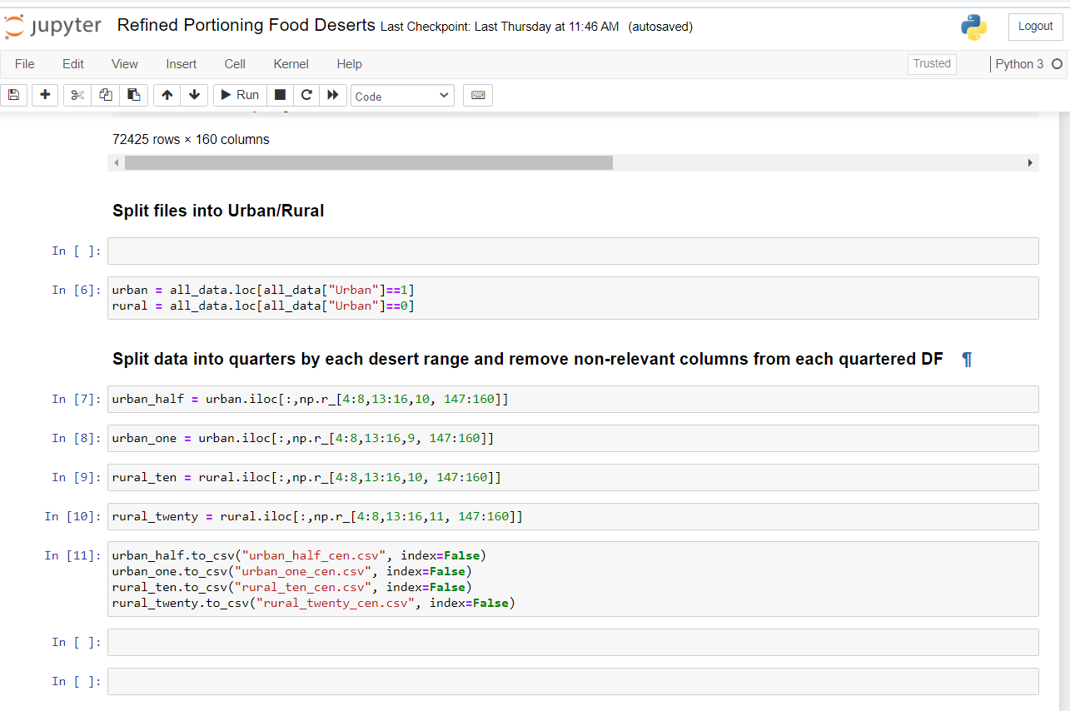
Splitting data for different models

Slide 14
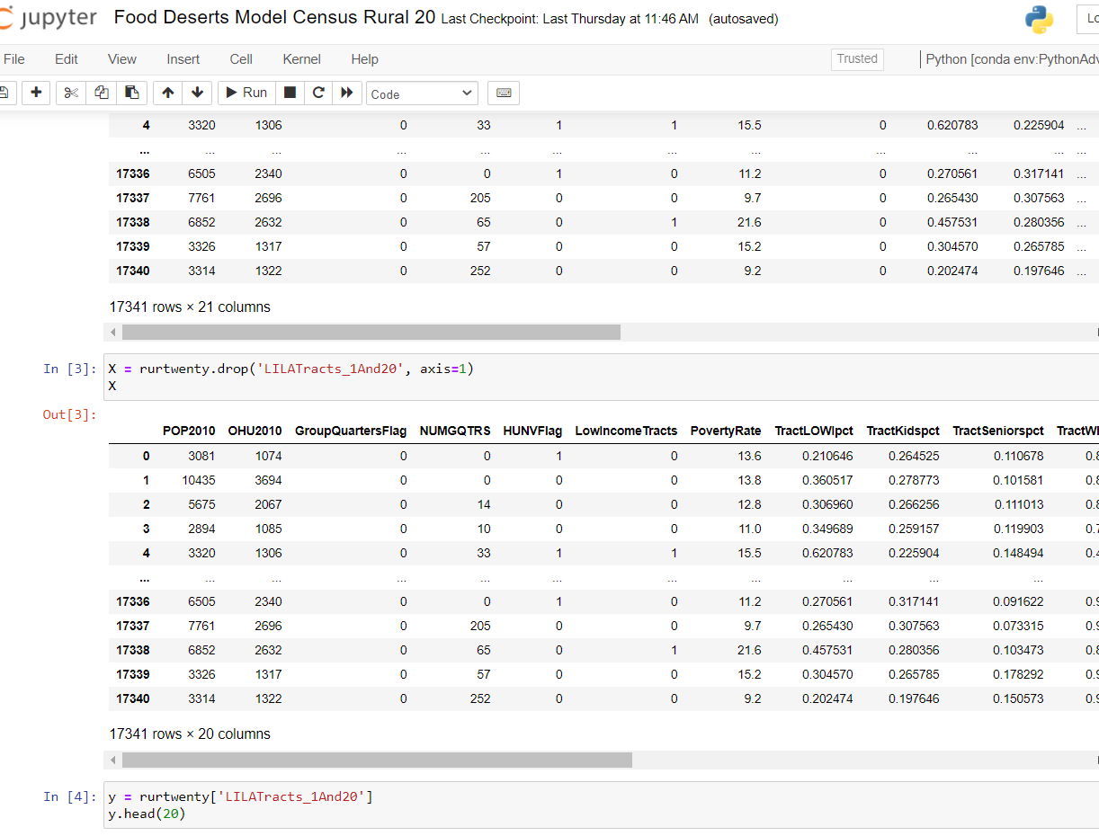
Selecting food desert flag as verification

Slide 15
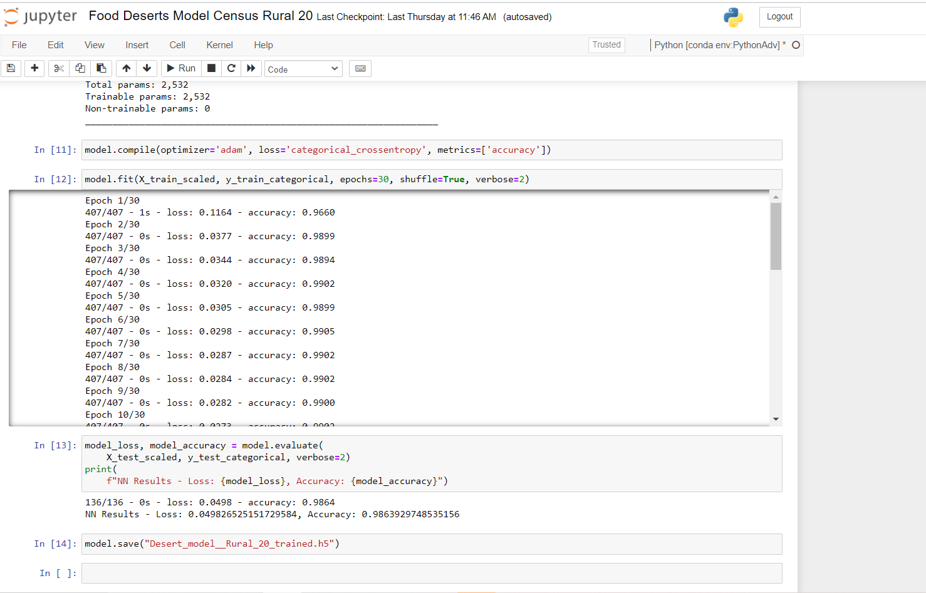
Training Model

Slide 16
Food Desert Website
Check out our website to learn more about food deserts and take action!
https://final-food-desert.herokuapp.com/

